Slide 1
ПРОДУКТОВЫЕ РЕШЕНИЯ СИБУР ДЛЯ СЕГМЕНТА НЕТКАНЫХ МАТЕРИАЛОВ
Вебинар Нетканые материалы: Вчера, Сегодня, Завтра
29.11.2021

Slide 2
ПРОИЗВОДСТВЕННЫЕ ПЛОЩАДКИ БАЗОВЫХ ПОЛИМЕРОВ
ЗапСибНефтехим (СИБУР Тобольск до 2020 г.)
НПП Нефтехимия*
ЗапСибНефтехим (с 2019 г.)
ПП (гомо)
Продуктовая специализация:
БОПП пленка
Нетканые материалы
Литье под давлением
Рафия
Нити и волокна
ПП (гомо)
Продуктовая специализация:
Литье под давлением
Термоформование
ПП (сополимеры), ПЭВП, ЛПЭНП
Продуктовая специализация ПП:
Литье под давлением
Компаунды
Трубы
Продуктовая специализация ПЭ:
Трубы
Выдувные изделия
Пленки
Литье под давлением
130
500
тыс. тонн в год
1500
тыс. тонн в год
500
тыс. тонн ПЭВП, ЛПЭНП
в год
тыс. тонн ПП в год
ПОЛИОМ*
МОСКВА
Томскнефтехим
140
ПП (гомо)
Продуктовая специализация:
Рафия
БОПП пленка
КАСТ пленка
Ненапорные трубы
ПП (гомо, стат) и ПЭНП
Продуктовая специализация:
Рафия
Нетканые материалы
Напорные трубы
ПЭ пленки
тыс. тонн ПП в год
210
Тобольск
270
тыс. тонн в год
Омск
тыс. тонн ПЭНП в год
Томск
* Совместное предприятие

Slide 3
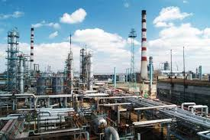
ТОМСКНЕФТЕХИМ
Ключевые продукты и технологии
GP
Линия А
Линия В
BM
PP H030 GP
PP H270 GP
PP H350 GP
PP R015 BM
PP R018 BM
PP R020 BM
Основная информация
Мощность: ПП: 140 тыс. тонн
Линия А (Homo) – 80 тыс. тонн
Линия В (Random) – 60 тыс. тонн
Технология: Суспензионный процесс Montedison
CM
CF
PP H022 CM
PP R085 CF
BF
* 99% общего объема выпуска
PP H031 BF
PP H041 BF
EX
PP R003 EX*
FF
PP H033 FF
РР H270 FF
РР H263 FF
РР H350 FF
CM
PP R022 CM
IM
IM
РР H451 IM
РР H452 IM
PP R451 IM
PP R651 IM
* Марки могут быть выпущены на обеих линиях

Slide 4
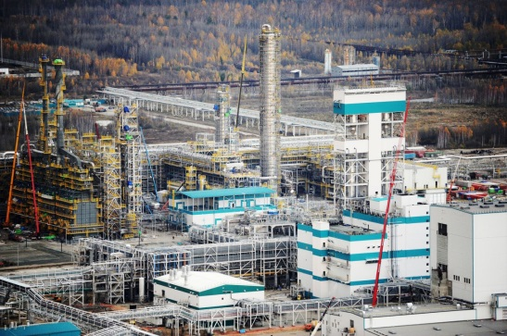
ЗАПСИБНЕФТЕХИМ. Innovene PP
Ключевые продукты и технологии
Линия 1
Линия 2
BF
GP
Основная информация
PP H031 BF
PP H036 BF
Мощность: ПП: 500 тыс. тонн
Линия 1 (Homo) – 250 тыс. тонн
Линия 2 (Homo) – 250 тыс. тонн
Технология: Полимеризации пропилена в газовой фазе «INNOVENE PP» (INEOS)
PP H250 GP
GP
FF
PP H030 GP
PP H253 FF
PP H263 FF
PP H270 FF
PP H350 FF
PP H363 FF
FF
PP H033 FF
PP H034 FF
PP H064 FF
* Марки могут быть выпущены на обеих линиях

Slide 5
ЗАПСИБНЕФТЕХИМ. Spheripol PP
Ключевые продукты и технологии
Линия 3
Линия 4
BF
Основная информация
PP H031 BF
PP H036 BF
GP
Мощность: ПП: 500 тыс. тонн
Линия А (Homo) – 250 тыс. тонн
Линия В (Homo) – 250 тыс. тонн
Технология: «Spheripol PP» (LyondellBasell)
PP H030 GP/3
PP H120 GP/3
PP H250 GP/3
PP H270 GP/3
PP I450 GP/3
EX
PP R003 EX
FF
PP H033 FF
PP H253 FF
PP H263 FF
PP H270 FF
PP H350 FF
PP H363 FF
IM
PP I122 IM/3
PP I452 IM/3
PP R481 IM/3

Slide 6
Текущие продуктовые решения для сегмента нетканых материалов
Основные свойства
Описание
ПТР, г/10 мин
Марка СИБУР
Гомополимер пропилена с узким молекулярно-массовым распределением. Продукт характеризуется высокой текучестью, оптимальным составом рецептуры стабилизации, обеспечивающим сбалансированные физико-механические характеристики.
PP H270 FF
27
PP H350 FF
35
PP H263 FF
27
Гомополимер пропилена с узким молекулярно-массовым распределением. Продукт характеризуется бесфталатностью, высокой текучестью и специальным составом рецептуры стабилизации, обеспечивающим сбалансированные физико-механическими характеристики, а также стойкость материала к воздействию окружающей среды (AGF-эффект).
PP H363 FF
35
Преимущества продуктовых решений
Улучшенная технологичность при переработке
Бесфталатность
Повышенная стойкость к выцветанию изделий
Сбалансированные физико-механическими характеристики

Slide 7
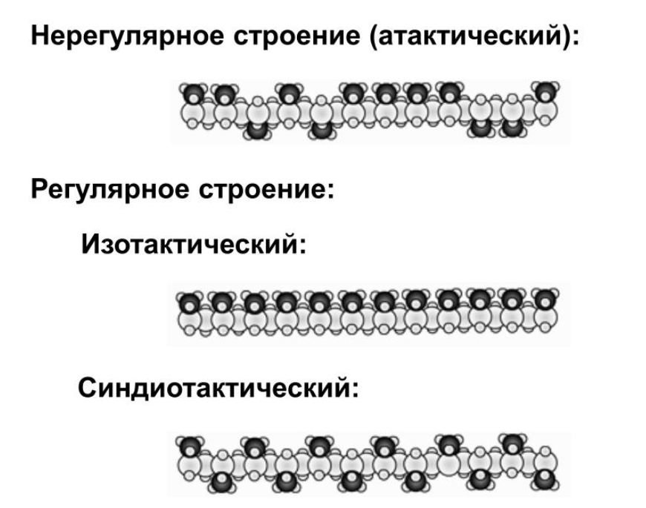
Ключевые факторы качества
Молекулярная структура
Структура полипропилена
Notes:
Those who follow us on a regular basis are aware of our key events in 2014, as most of them happened in the first half and were covered in September earlier this year during the previous conference call.
I will shortly go through the key topics:
The environment was overall difficult, but remained rather favourable for SIBUR in the first 9 months of the year
Russian economy was approaching stagnation and have already posted accelerating inflation
Oil prices have started declining year-on-year by the end of the period, naphtha prices were largely flat, while prices for LPG demonstrated mixed dynamics on different markets
Material rouble depreciation positively affected our revenue and EBITDA, but resulted in a significant foreign exchange losss
We have almost completed the investment cycle, when we expanded transportation and feedstock processing capacities and launched new petrochemical capacities:
Now we collect additional volumes of feedstock from the northern regions of Werstern Siberia via the new sections of the pipeline and process them at our expanded capacity in Tobolsk
Ramp-up at our new polypropylene production in Tobolsk has been almost finished (Production volumes: 141.7 kt in 9M, 42.9 kt in Q3)
Energy products trading operations via Ust-Luga totaled 1,053 kt of naphtha and LPG, while total loading volumes amounted to 1,749 kt of naphtha, 845 kt of LPG and 151 kt of diesel fuel
In September, RusVinyl, the new PVC production complex constructed under JV with SolVin, was launched. At the same time, we have recorded first sales of ethylene, which is a key raw material for PVC, from our recently expanded cracking capacity in Kstovo
Last time we announced approval of ZapSibNeftekhim by SIBUR Board of Directors
Since then, we have signed contracts with key engineering and procurement contractors, being Linde for the ethylene cracker, ThyssenKrupp for the polypropylene production unit and Technip for the polyethylene production unit
We have also received approvals from Euler Hermes and Coface for ECA-cover for these contracts
And most recently we have opened a new 5yr credit line of RR 42 bln with Sberbank providing us with access to long-term liquidity

Slide 8
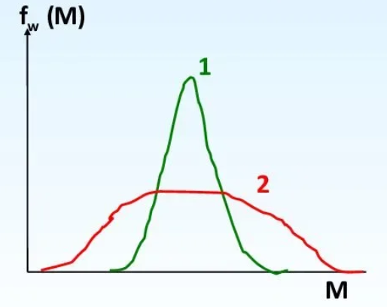
Ключевые факторы качества
Молекулярно-массовые характеристики
Notes:
Those who follow us on a regular basis are aware of our key events in 2014, as most of them happened in the first half and were covered in September earlier this year during the previous conference call.
I will shortly go through the key topics:
The environment was overall difficult, but remained rather favourable for SIBUR in the first 9 months of the year
Russian economy was approaching stagnation and have already posted accelerating inflation
Oil prices have started declining year-on-year by the end of the period, naphtha prices were largely flat, while prices for LPG demonstrated mixed dynamics on different markets
Material rouble depreciation positively affected our revenue and EBITDA, but resulted in a significant foreign exchange losss
We have almost completed the investment cycle, when we expanded transportation and feedstock processing capacities and launched new petrochemical capacities:
Now we collect additional volumes of feedstock from the northern regions of Werstern Siberia via the new sections of the pipeline and process them at our expanded capacity in Tobolsk
Ramp-up at our new polypropylene production in Tobolsk has been almost finished (Production volumes: 141.7 kt in 9M, 42.9 kt in Q3)
Energy products trading operations via Ust-Luga totaled 1,053 kt of naphtha and LPG, while total loading volumes amounted to 1,749 kt of naphtha, 845 kt of LPG and 151 kt of diesel fuel
In September, RusVinyl, the new PVC production complex constructed under JV with SolVin, was launched. At the same time, we have recorded first sales of ethylene, which is a key raw material for PVC, from our recently expanded cracking capacity in Kstovo
Last time we announced approval of ZapSibNeftekhim by SIBUR Board of Directors
Since then, we have signed contracts with key engineering and procurement contractors, being Linde for the ethylene cracker, ThyssenKrupp for the polypropylene production unit and Technip for the polyethylene production unit
We have also received approvals from Euler Hermes and Coface for ECA-cover for these contracts
And most recently we have opened a new 5yr credit line of RR 42 bln with Sberbank providing us with access to long-term liquidity

Slide 9
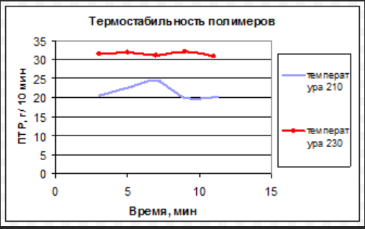
Ключевые факторы качества
Рецептура
Деструкция при переработке
Изменение цвета
Notes:
Those who follow us on a regular basis are aware of our key events in 2014, as most of them happened in the first half and were covered in September earlier this year during the previous conference call.
I will shortly go through the key topics:
The environment was overall difficult, but remained rather favourable for SIBUR in the first 9 months of the year
Russian economy was approaching stagnation and have already posted accelerating inflation
Oil prices have started declining year-on-year by the end of the period, naphtha prices were largely flat, while prices for LPG demonstrated mixed dynamics on different markets
Material rouble depreciation positively affected our revenue and EBITDA, but resulted in a significant foreign exchange losss
We have almost completed the investment cycle, when we expanded transportation and feedstock processing capacities and launched new petrochemical capacities:
Now we collect additional volumes of feedstock from the northern regions of Werstern Siberia via the new sections of the pipeline and process them at our expanded capacity in Tobolsk
Ramp-up at our new polypropylene production in Tobolsk has been almost finished (Production volumes: 141.7 kt in 9M, 42.9 kt in Q3)
Energy products trading operations via Ust-Luga totaled 1,053 kt of naphtha and LPG, while total loading volumes amounted to 1,749 kt of naphtha, 845 kt of LPG and 151 kt of diesel fuel
In September, RusVinyl, the new PVC production complex constructed under JV with SolVin, was launched. At the same time, we have recorded first sales of ethylene, which is a key raw material for PVC, from our recently expanded cracking capacity in Kstovo
Last time we announced approval of ZapSibNeftekhim by SIBUR Board of Directors
Since then, we have signed contracts with key engineering and procurement contractors, being Linde for the ethylene cracker, ThyssenKrupp for the polypropylene production unit and Technip for the polyethylene production unit
We have also received approvals from Euler Hermes and Coface for ECA-cover for these contracts
And most recently we have opened a new 5yr credit line of RR 42 bln with Sberbank providing us with access to long-term liquidity

Slide 10
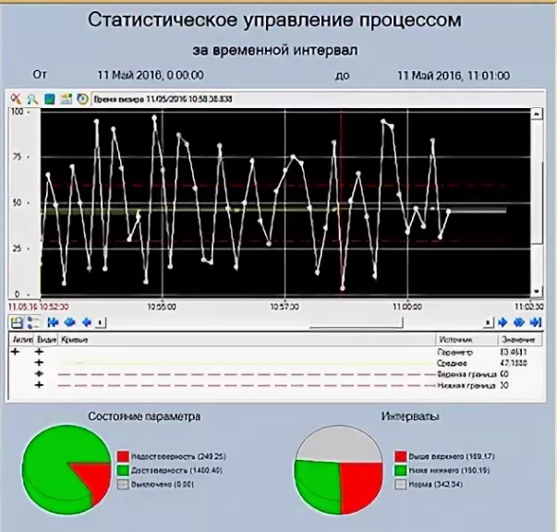
Ключевые факторы качества
Контроль процессов производства
Система качества должна строиться на снижении отклонений в процессе
Статистический контроль процессов производства продукции
НГС
ВГС
100
Цель
0

